Slide 1
Simulation of a Restaurant’s Seating Policy
Team Members:
Linkun Chen, Chenjun Feng, Zhixiu Liang, Saiyang Qi, Yunke Tian, Junao Wang
1

Slide 2
Background & Policy Rules
There is 40 seat space in the restaurant
Only use two-seat table(s) and four-seat table(s) (Denote K as the number of four-seat table and the rest are two-seat)
Customers come in groups containing 1, 2, 3 or 4 people with probability 1/4
Two groups never share a table
If both types of tables are available, a group containing 1 or 2 customers will get a two-seat table
o
2

Slide 3
Background & Policy Rules (Cont.)
A group containing 1 or 2 customers may take a four-seat table
A group containing 3 or 4 customers can only take a four-seat table
Modified first come first serve policy
It takes 20, 30, 35, and 45 minutes for 1, 2, 3 and 4 customers to eat
Customers always decide to leave after 15 minutes waiting in a line
The business hour is 11AM to 9PM
The buffet cost $20 each person
3

Slide 4

Data Collection & Input Distribution Selection
We repeat all the process below for each business hour
Collect the data from a real buffet restaurant
Record every minute of group(s) of customers’ arrivals within one hour
Draw the histogram
Hypothesize that it is a Poisson distribution
Estimate the parameter using MLE
Use Chi-Square test to evaluate the goodness of fit
4

Slide 5
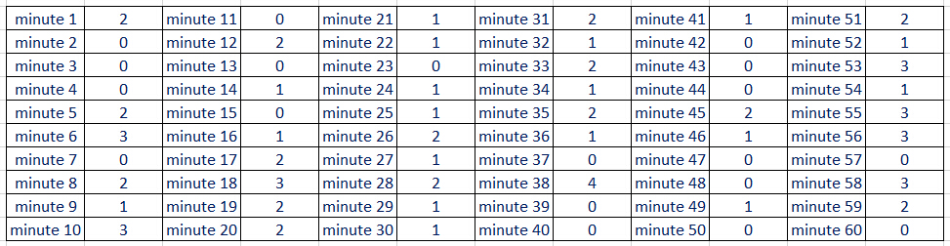
Data Collection & Input Distribution Selection (Cont.)
Noon - 13PM number of coming customer groups for every minute
5

Slide 6
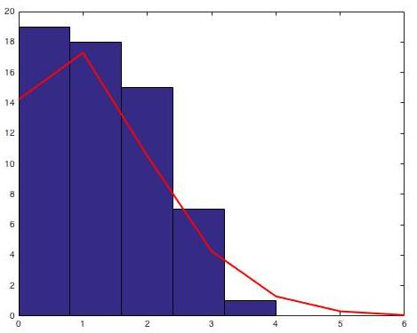
Data Collection & Input Distribution Selection (Cont.)
The number of minutes
The number of groups coming in one minute
6

Slide 7
Simulation Modeling Program in Matlab
Use random numbers to generate customers groups with the input distribution
A mechanism that handles first come first serve. and remove customers who waited for more than 15 minutes
A mechanism that records the tables, the change of seating status, and the customers’ eating time
A mechanism to decide if there is an empty seat with proper size for each group of customers from the head of the queue to the end
7

Slide 8
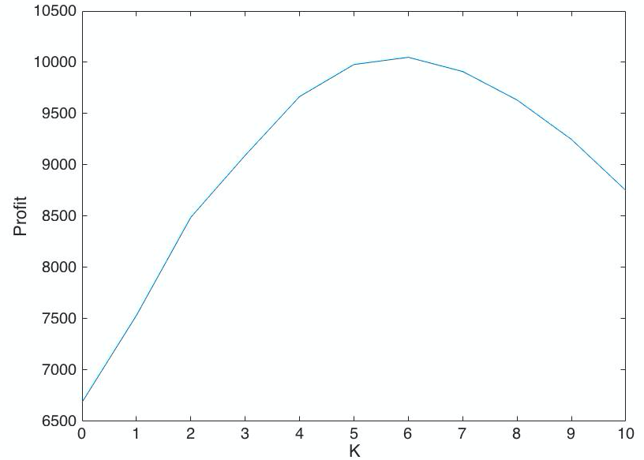
Output Analysis
Terminating simulation (Initial: empty at 11AM; Stopping event:10PM no more customer coming in)
For each K (0 -10) (K is the number of four-seat table), run the program 1000 times, record the average revenue for each K
The K that generates the most daily revenue gives the optimal seating arrangement
8

Slide 9
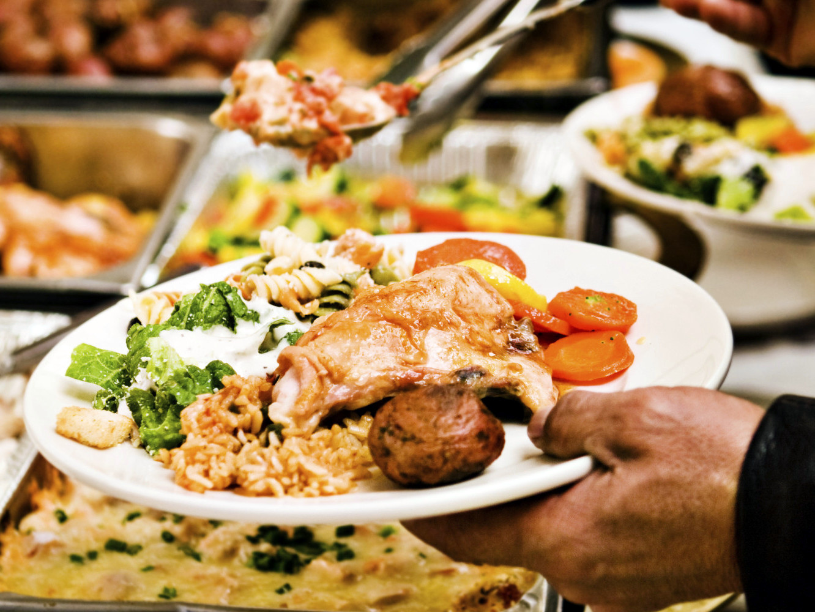
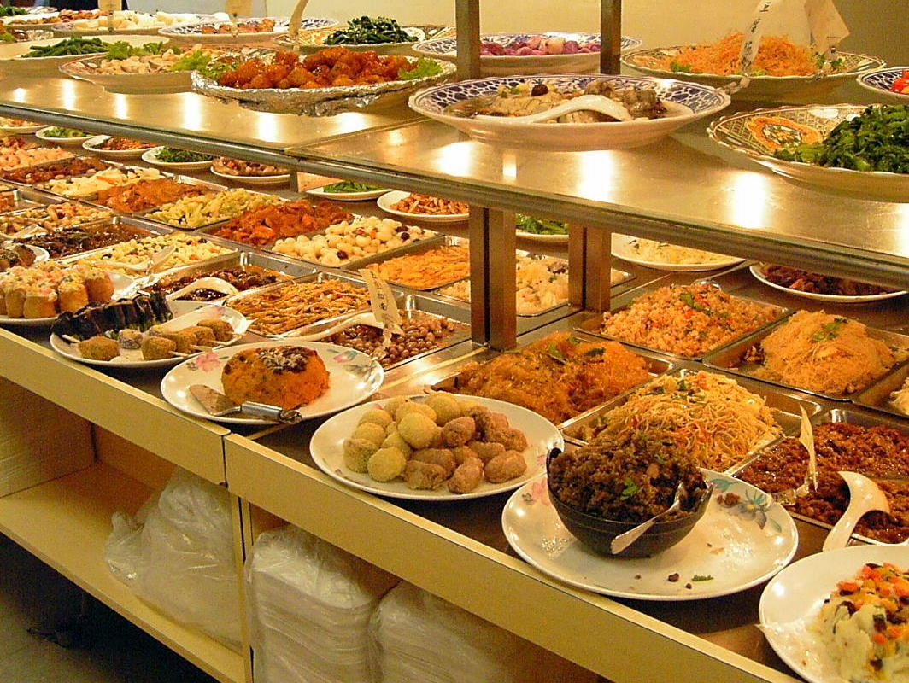
Future Work
The time that customers would like to wait in the line can be random
The number of customers in a group can be random (Ex: 8 people in a group)
More types of tables are allowed (Ex: one-seat table)
Customer’s eating time can be random
9

Slide 10
Thank You!
10

